Slide 1


Smart Road Management System
Supervised By :
DR. Wael Abbas

Slide 2
Our Team
Kareem hani 202000675
Abdelrahman Ayman 202000503
Omar Ramadan 202000595
Mazen Mohamed 202000707
Yassen Sameh 202001056
Ahmed Aymen 202000016

Slide 3
AGENDA
Overview Of Project Idea
Motivation & Problem Definition
Project Target
Software Development Phases
System Architecture
System Tools

Slide 4

Overview Of Project Idea
Our system outlines a comprehensive plan to address the escalating issue of road accidents in Egypt, particularly focusing on the surge in fatalities and injuries caused by safety protocol violations, primarily speeding.
The main objective of the project is to enhance road safety and reduce traffic accidents by implementing a smart radar system utilizing big data and machine learning technologies. The report encompasses feasibility studies, analysis of the existing system's limitations, requirements for the new system, advantages of the proposed system, and strategies for risk management. By deploying this system, we aim to make road environment more safer and a reduction in traffic accidents and injuries.

Slide 5
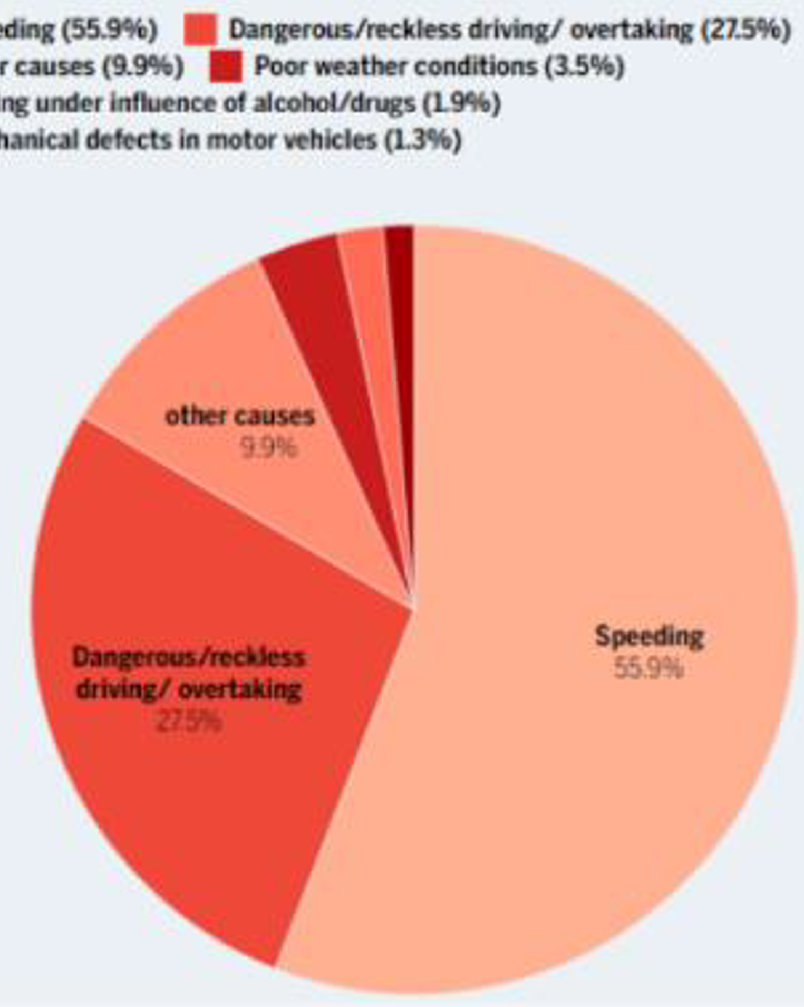

Motivation & Problem Definition
According to Arab 48 newspaper, corresponding to 12/31/2023, the number of road accidents reached 333, compared to 319 fatal accidents in 2022, representing an increase of about 5%, due to several reasons, with most accidents occurring due to speeding.

Slide 6
Motivation & Problem Definition
Another problem we face is that there is a lot of diverse data , which may cause collisions between the data and each other ,which makes the system unreliable or may preform functions incorrectly. These processes also require accuracy ,speed ,and complete ,correct data to be able to identify the violating vehicles or determine their data

Slide 7
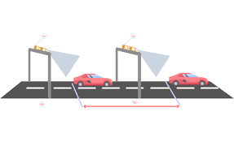
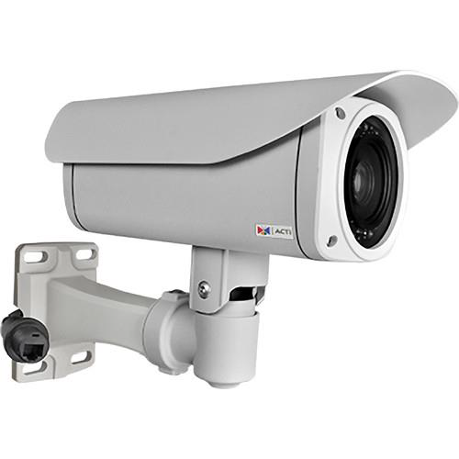
Motivation & Problem Definition
Using multiple surveillance cameras along the road to detect cars violating traffic laws (Speed) is considered very costly.
ACTi B47 camera has some specifications for which that we need to reach to a good result from our application. These specifications are:
Maximum resolution 3MP
Day/Night
Adaptive IR LED
Lens:
Zoom,
f5.2-62.4mm / F1.8-3.0,
DC iris,
Auto focus,
Maximum Frame Rate (30 fps) at 1920 x 1080

Slide 8
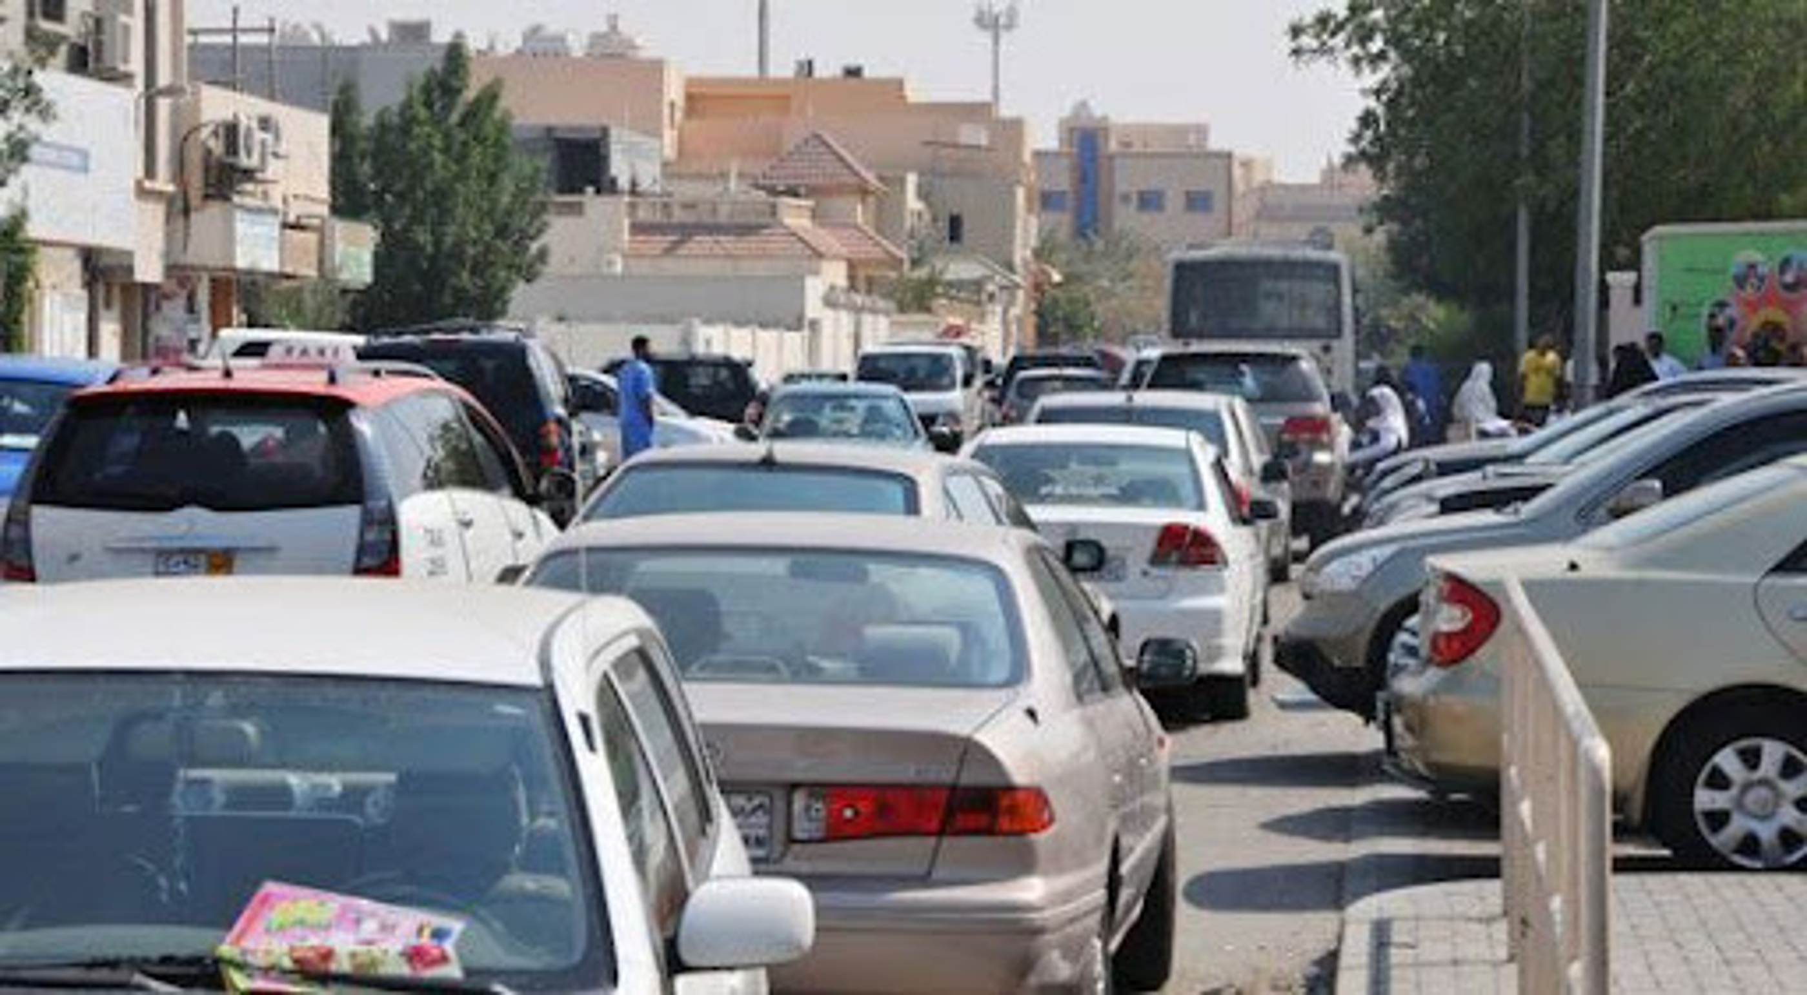
Motivation & Problem Definition
Traffic congestion during the passage to pay traffic and road taxes.

Slide 9
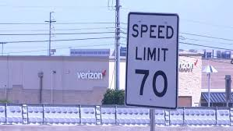
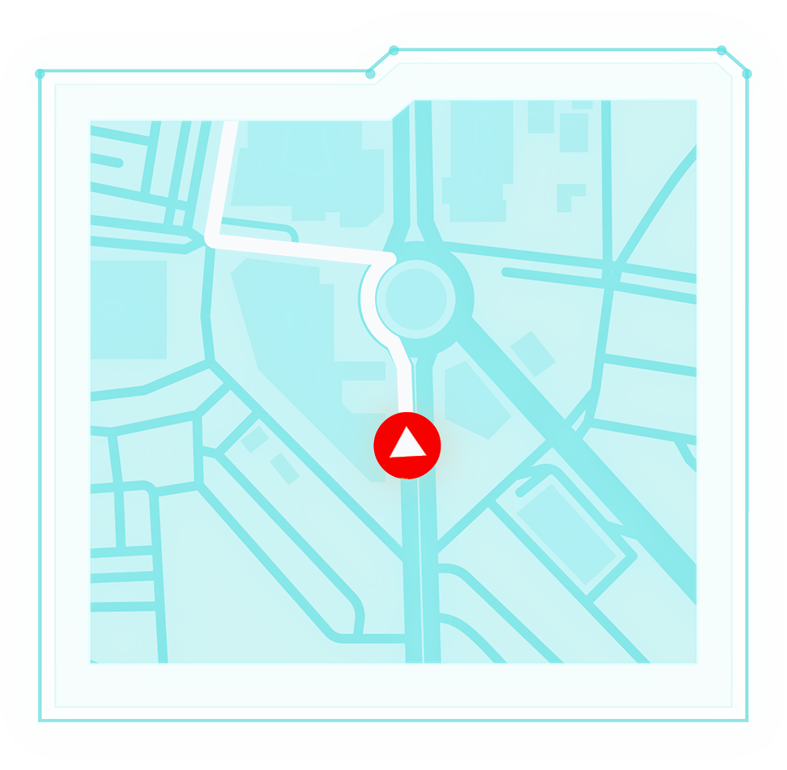
Project Target (Solutions):
Creating a proficient detection system for identifying infractions and preventing collisions, including the implementation of legally mandated intervals between checkpoints, thereby compelling drivers to adhere to speed limits, ultimately enhancing road safety and diminishing traffic incidents and casualties.
Leveraging big data analysis enables the identification of congested and high-risk areas, leading to improved road efficiency and decreased congestion and violations.

Slide 10
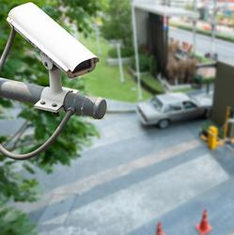
Project Target (Solutions):
Employing affordable tools and devices offers cost-saving advantages, making it an attractive option for stakeholders or relevant authorities.

Slide 11
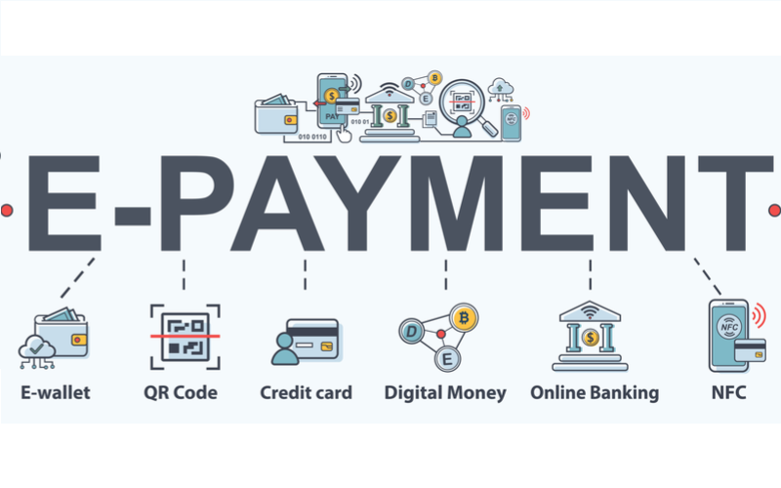
Project Target (Solutions):
Implementing an online payment system via electronic gateways aims to alleviate car congestion at gates.

Slide 12





Software Development Phases
5th
1st
3rd
User Interface
AI Systems
Notification
and alert
testing software
Big Data
2nd
4th

Slide 13
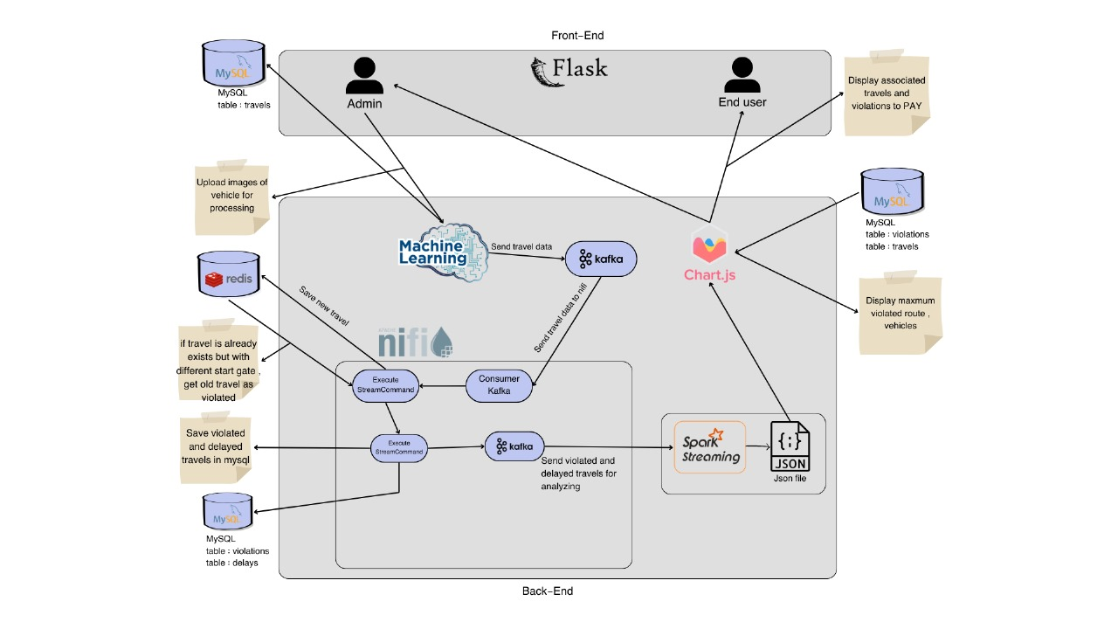
System Architecture

Slide 14

System Tools
Redis (NoSQL Database)
is an open source, in-memory, NoSQL key/value store that is used primarily as an application cache or quick-response database

Slide 15

System Tools
NIFI (ETL Tool)
powerful enterprise-grade dataflow management tool that can collect, route, enrich, transform and process data in a reliable and scalable manner.

Slide 16

System Tools
Redis (NoSQL Database)
Apache Spark is an open-source distributed computing system that is designed for big data processing and analytics. It provides an interface for programming entire clusters with implicit data parallelism and fault tolerance. Spark is known for its speed, versatility, and ease of use.

Slide 17
THANKS

